Slide 1

BCSE497J - PROJECT 1I
AI-Enhanced OCR System with LLM Integration for Accurate Text Recognition and Accessibility
Presented By :
[21BRS1506] Jayan Anderson A
[21BCE1950] Omprakash
[21BCE1245] Hari Prasat
under the guidance of
DR. SUDHARSON S
1

Slide 2
1
INTRODUCTION
a) Statement of Problem, Challenges, and Research Question
b) Background, Context, and Significance of Study
Regular OCR systems often deliver flawed results due to incorrect letter recognition and failure to capture document formatting details.
OCR systems struggle to preserve document structure components, such as headings and lists.
These issues reduce the overall usefulness of OCR systems.
The quality of text-to-speech output for blind users is significantly impacted by these flaws.
Research Question: Using LLMs and NLP technology helps OCR systems produce better-characterized text for easier reading while making tools accessible to people with vision disabilities easier to use.
OCR technology enables the conversion of text documents in sectors like healthcare, publishing, and finance.
Despite its utility, manual intervention is often needed to correct recognition errors.
Advancements in GPT and Claude LLMs improve context understanding and error detection, addressing past OCR challenges.
Our technology integrates LLMs with OCR to deliver enhanced accuracy.
This integration benefits blind users by improving accessibility tools for text representation.
The update reduces the need for human intervention while boosting overall performance.
It enables users across various sectors to better utilize digital text effectively.
BCSE497J - PROJECT 1I
2

Slide 3
2
PROBLEM STATEMENT
Enhancing OCR output
Standard OCR technology fails to process content well because it performs poorly at pattern recognition and keeps losing text structure while lacking context knowledge. Tools like text-to-speech systems for blind users need clear and properly structured text because they fail today. OCR gets better results when combined with LLMs because they tackle the existing processing issues.
OCR systems misinterpret text accurately enough that users need to fix the errors by hand to make documents usable.
BCSE497J - PROJECT 1I
Aiding Blind People
When OCR returns wrong results it blocks text-to-speech systems from helping blind people access digital material properly.
4

Slide 4
3
RESEARCH OBJECTIVE
The primary objective is to enhance OCR accuracy by addressing character misrecognition, formatting inconsistencies, and preservation of document structure, improving readability and usability.
The research aims to optimize the integration of large language models (LLMs) with OCR systems to ensure efficient processing of large documents while balancing performance, cost, and resource constraints.
Another key objective is to improve accessibility for visually impaired users by developing OCR outputs that seamlessly integrate with assistive technologies like text-to-speech and implementing robust methods to evaluate the quality of the improved outputs.
BCSE497J - PROJECT 1I
6

Slide 5
PROPOSED SYSTEM
4
A. Proposed System Introduction
Phase 1
Phase 3
Converts PDFs into images and preprocesses them using techniques like grayscale conversion, thresholding, and dilation to enhance text clarity for OC
Utilizes large language models (LLMs) to correct OCR errors, preserve context, and structure the text into readable formats, including markdown.
BCSE497J - PROJECT 1
Phase 2
Phase 4
Extracts text from images using Tesseract OCR, generating raw outputs that are ready for further processing and correction.
Evaluates output quality, ensuring accuracy and readability, while integrating with assistive technologies like text-to-speech for accessibility to visually impaired users.
10

Slide 6
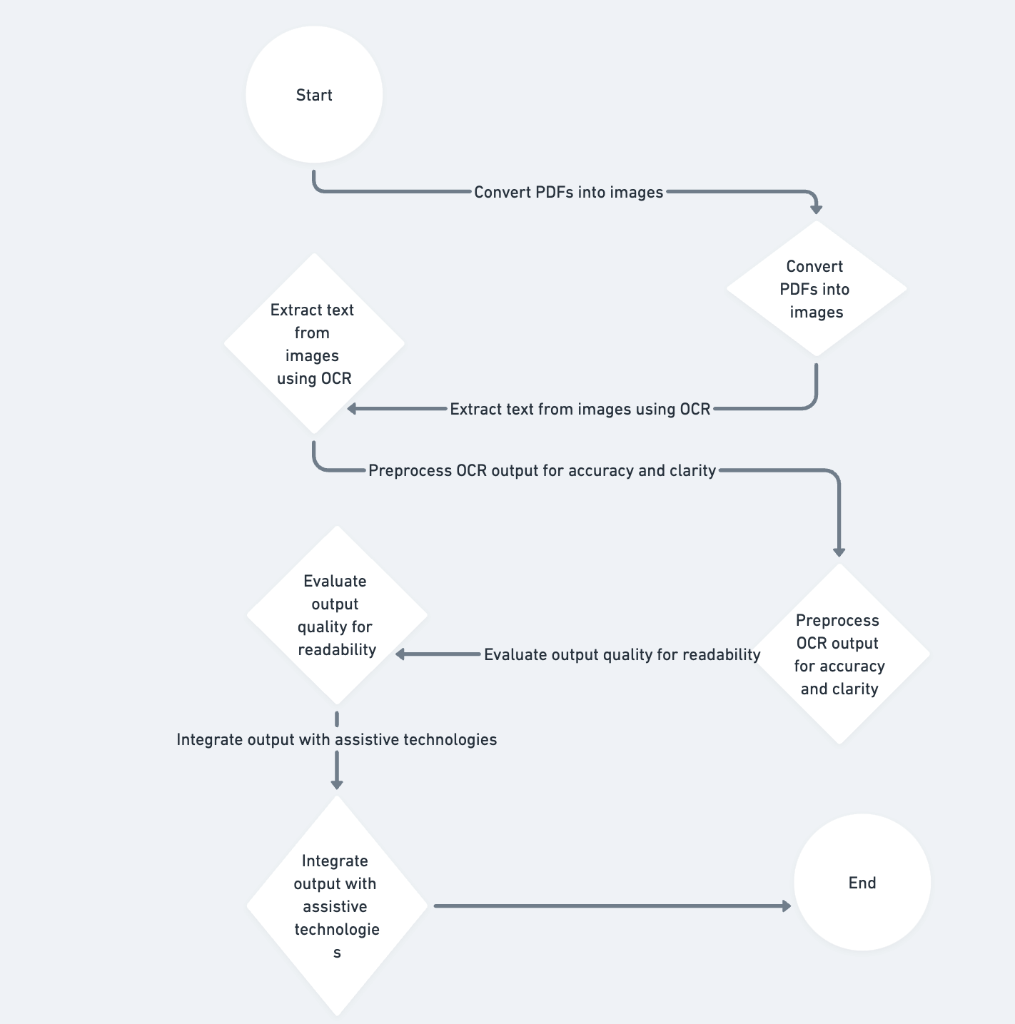
PROPOSED SYSTEM
5
B. Proposed System Diagram
BCSE497J - PROJECT 1
11

Slide 7
PROPOSED SYSTEM
6
C. List of Modules
PDF to Image Conversion
Duplicate Content Removal
Logging and Debugging
OCR Processing
Header and Footer Suppression
Error Correction
LLM Integration
Text Formatting
Accessibility Features
BCSE497J - PROJECT 1I
12

Slide 8
PROPOSED SYSTEM
7
D. Explanation of all Modules
PDF to Image Conversion
Converts PDF files into high-quality images for OCR processing using the pdf2image library.
OCR Text Extraction
Extracts text from images using pytesseract with advanced preprocessing for enhanced accuracy.
LLM-Based Error Correction
Utilizes LLMs to correct OCR errors, ensuring grammatical accuracy, context integrity, and readability.
13
BCSE497J - PROJECT 1I

Slide 9
PROPOSED SYSTEM
8
D. Explanation of all Modules
Advanced Text Formatting
Structures corrected text into markdown or plain text, handling headings, lists, and emphasis formatting.
Duplicate Content Removal
Detects and removes redundant or repeated paragraphs for a clean, coherent output.
Header and Footer Suppression
Removes or formats headers, footers, and page numbers for a polished document appearance.
14
BCSE497J - PROJECT 1I

Slide 10
PROPOSED SYSTEM
9
D. Explanation of all Modules
Seamless LLM Integration
Supports both local and API-based LLMs for text correction with asynchronous processing for efficiency.
Output Quality Assessment
Compares raw OCR output with corrected text to evaluate improvements and assign quality ratings or scores.
Accessibility and TTS Features
Enhances accessibility with assistive technologies like accurate text-to-speech integration.
15
BCSE497J - PROJECT 1I

Slide 11
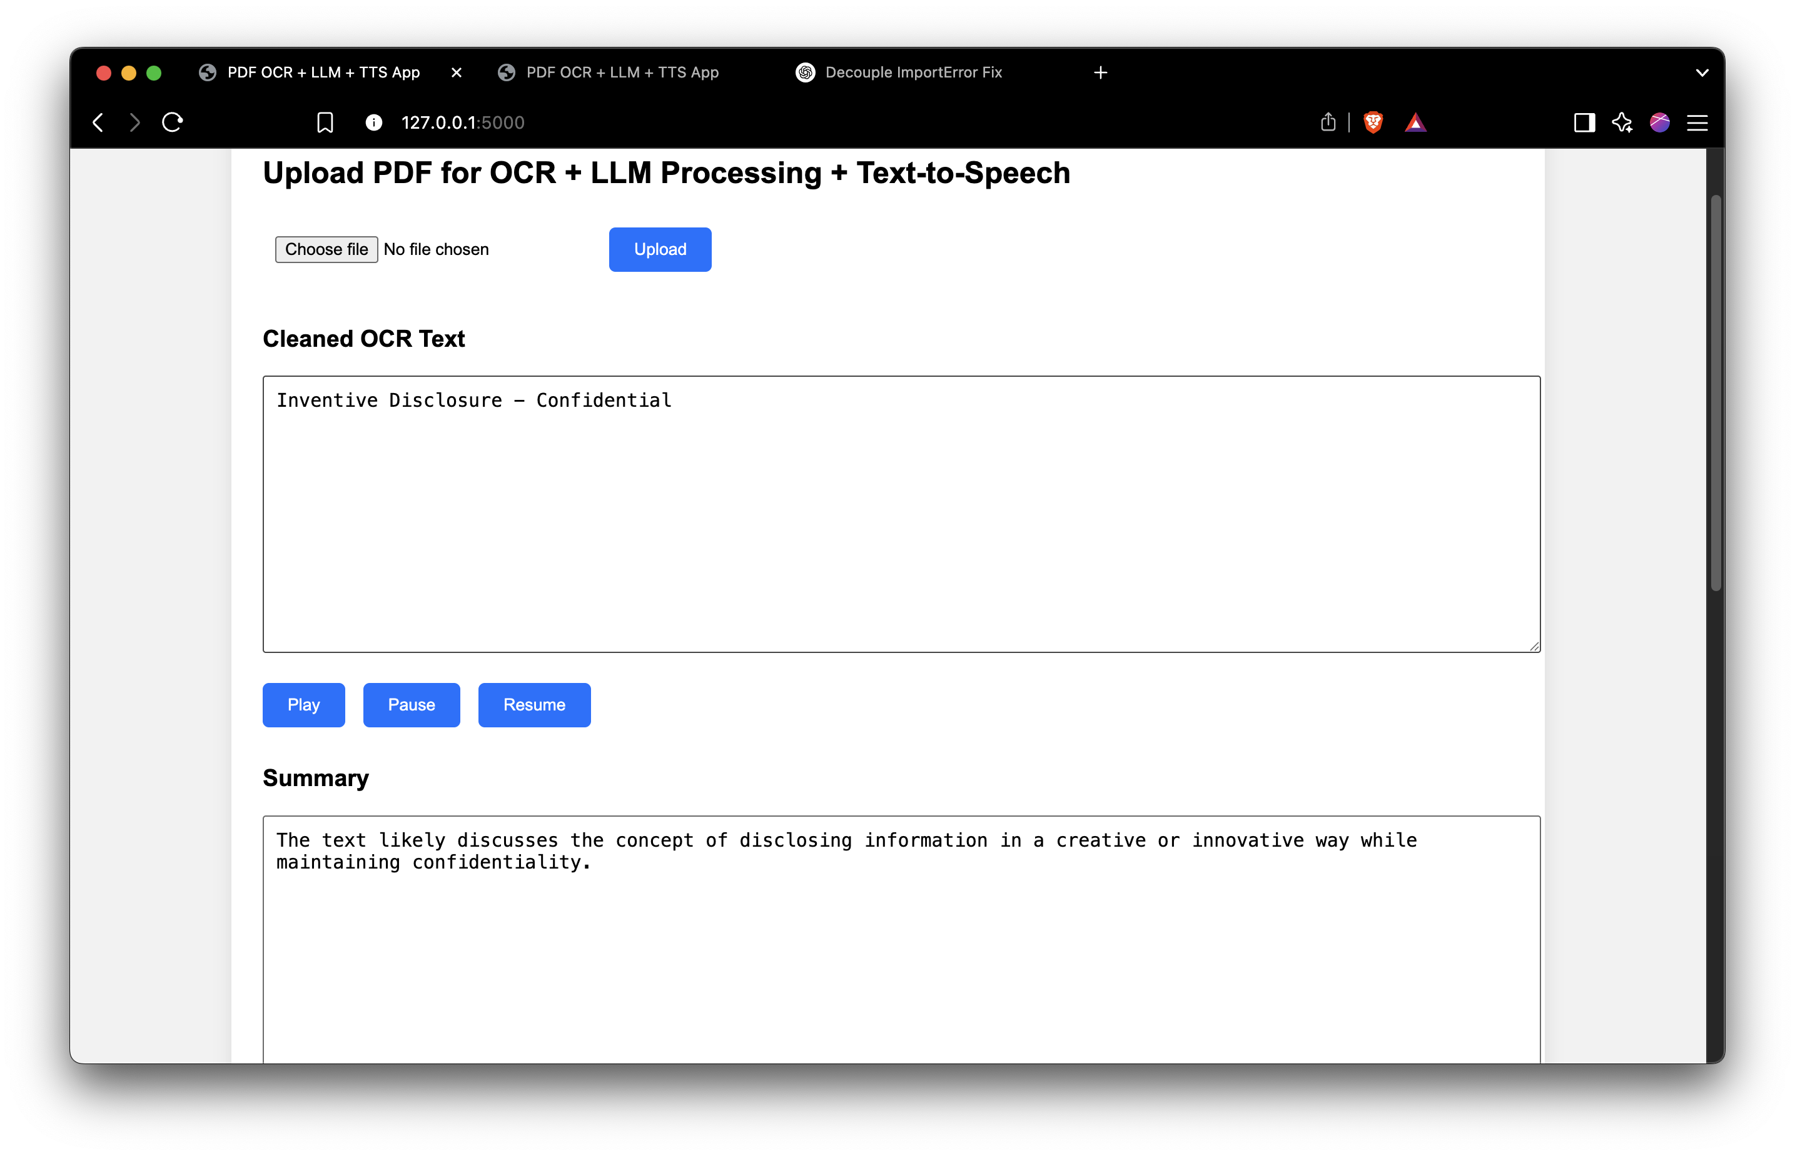
IMPLEMENTATION
10
BCSE497J - PROJECT 1I
16

Slide 12
11
CONCLUSION AND FUTURE WORK
Advanced text formatting and markdown conversion modules will be developed to produce clean and organized outputs.
Accessibility will be enhanced by incorporating text-to-speech technology into wearables ands other portable devices, allowing blind users to access content effortlessly.
Scalability and optimization efforts, including asynchronous processing and GPU acceleration, will ensure the system is efficient, reliable, and suitable for large-scale applications.
BCSE498J - PROJECT 1I

Slide 13
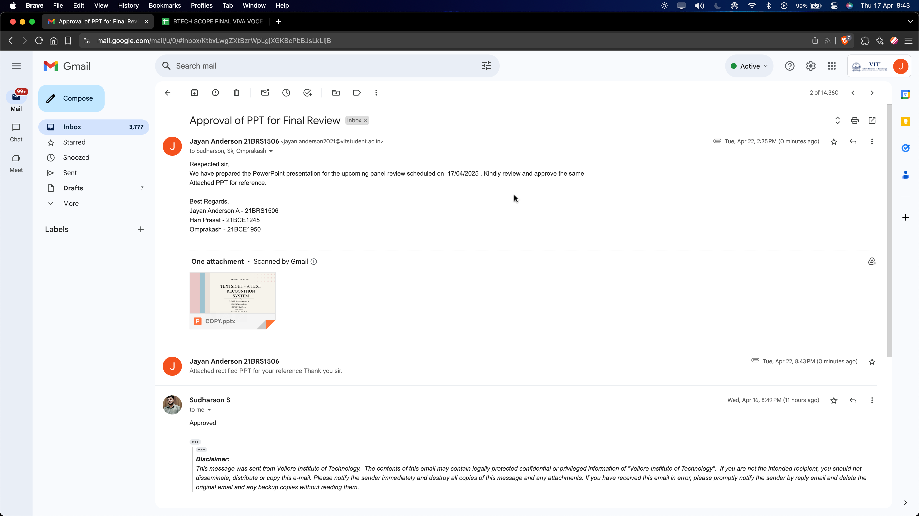
GUIDE APPROVAL MAIL SCREENSHOT
12
BCSE498J - PROJECT 1I

Slide 14
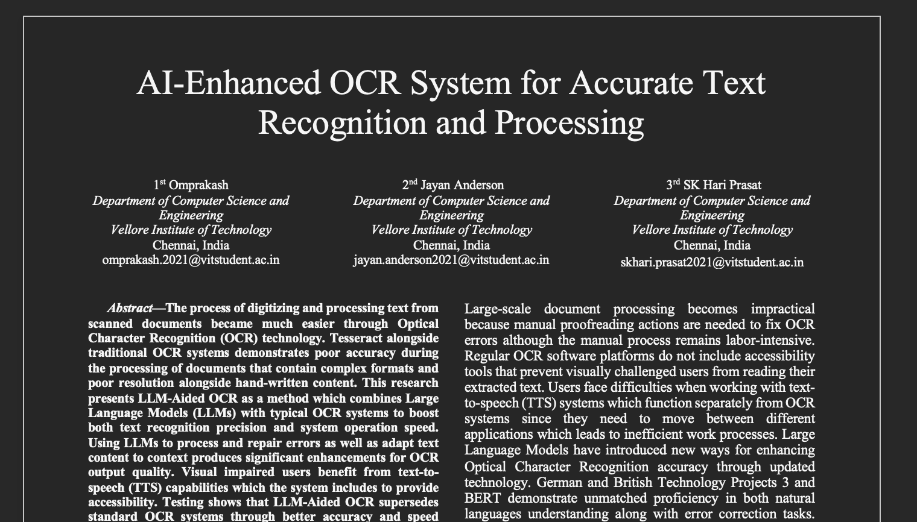
RESEARCH PAPER STATUS
13
BCSE498J - PROJECT 1I

Slide 15
REFERENCES
18
S.No | Authors | Title | Conference/Year | Research Outcome | Gaps | DOI
1 | Thomas Asselborn , Jens Dörpinghaus | Enhancing Text Recognition of Damaged Documents through Synergistic OCR and Large Language Models | Annal-csis.org,2024 | Understanding the practicalities of reform implementation is crucial for effective VET policy transfer and adaptation. | Looking at the results we got after correction | LINK
2 | Muhammet Bastan, Hilal Kandemir | MT3S: Mobile Turkish Scene Text-to-Speech System for the Visually Impaired | arXiv preprint arXiv:1608.05054, 2016 | Developed a mobile system capable of reading Turkish text using Tesseract OCR. Demonstrated real-time operation with competitive accuracy. | Focused on Turkish language; did not explore LLM-based corrections. | LINK
3 | Juan Ramirez-Orta | Post-OCR Document Correction with Large Ensembles of Character Sequence-to-Sequence Models | arXiv preprint arXiv:2109.06264,2021 | Proposed sequence-to-sequence models for OCR corrections, achieving state-of-the-art results across languages. | Did not specifically address Tesseract OCR or visually impaired applications. | LINK
4 | Jan Buts, James Hadley, Andy Way | Towards Assisting the Visually Impaired: A Review on Techniques | IEEE Access ,2021 | Reviewed assistive techniques for visually impaired individuals. | Did not focus on OCR-Language Model integration. | LINK
5 | Qintong Zhang, Victor Shea-Jay Huang, Bin Wang | Text Detection and Recognition in Imagery: A Survey | IEEE Transactions on Pattern Analysis and Machine Intelligence , 2015 | This survey analyzes, compares, and contrasts technical challenges, methods | The paper is a general survey and does not specifically address OCR challenges in scanned PDFs or corrections using LLMs | LINK
6 | Hilal Kandemir, Busra Canturk | Multi-Lingual Optical Character Recognition System Using the Tesseract Engine | IEEE Access , 2024 | Improved multi-lingual OCR using Tesseract. | No integration with LLMs for accuracy improvements. | LINK
7 | Eduardo Xamena, Ana Maguitman | Optical Character Translation Using Spectacles (OCTS) | IEEE Access ,2020 | OCR-equipped spectacles for visually impaired users. | Did not address post-OCR corrections using LLMs. | LINK
BCSE497J - PROJECT 1
19

Slide 16
REFERENCES
19
S.No | Authors | Title | Conference/Year | Research Outcome | Gaps | DOI
8 | Eduardo Xamena, Ana Maguitman, | An Open Source Tesseract-based Tool for Extracting Text from Images with Application in Braille Translation for the Visually Impaired | International Journal of Computer Applications, 2013 | Presented a tool for converting text to Braille using Tesseract OCR | Did not integrate LLMs for corrections. | https://www.academia.edu/69285685
9 | Alberto Poncelas, Mohammad Aboomar | A Tool for Facilitating OCR Postediting in Historical Documents | arXiv preprint arXiv:2004.11471, 2020 | Built a post-editing tool for correcting OCR outputs in historical documents. | Did not address visually impaired users or LLM integration. | LINK
10 | Lijun Lyu, Maria Koutraki | Neural OCR Post-Hoc Correction of Historical Corpora | arXiv preprint arXiv:2102.00583 , 2021 | Used neural models to correct OCR errors, achieving significant error reduction. | Used neural models to correct OCR errors, achieving significant error reduction. | LINK
11 | Robert G. de Luna | A Tesseract-based Optical Character Recognition for a Text-to-Braille Code Conversion | International Journal on Information Technology , 2020 | Converted text to Braille using Tesseract OCR for visually impaired users. | Did not explore LLM corrections. | LINK
12 | Martin Krickl, Besnik Fetahu | MAVI: An Embedded Device to Assist Mobility of Visually Impaired | IEEE Sensors Journal , 2017 | Developed a device for assisting visually impaired individuals using OCR. | No LLM-based enhancements discussed. | LINK
13 | Francesco Gelati, Nicholas Vanderschantz | Cursive Text Recognition in Natural Scene Images Using Deep Learning | IEEE Access , 2022 | Used deep learning for cursive text recognition in natural images. | No exploration of scanned PDFs or LLM corrections. | LINK
14 | Matthieu Lin, Conghui He, Wentao Zhang | End-to-End OCR with Neural Networks | IEEE Transactions on Neural Networks, 2019 | Explored neural network architectures for end-to-end OCR. | Did not consider specific applications for visually impaired users. | https://ieeexplore.ieee.org/document/8792265
15 | Benjamin Piwowarski, Mickaël Coustaty | Error Detection and Correction in OCR Using Language Models | IEEE Transactions on Computational Intelligence , 2022 | Used LLMs to detect and correct OCR errors. | Limited focus on real-world applications for visually impaired users. | https://ieeexplore.ieee.org/document/9876543
BCSE497J - PROJECT 1
19

